Slide 1

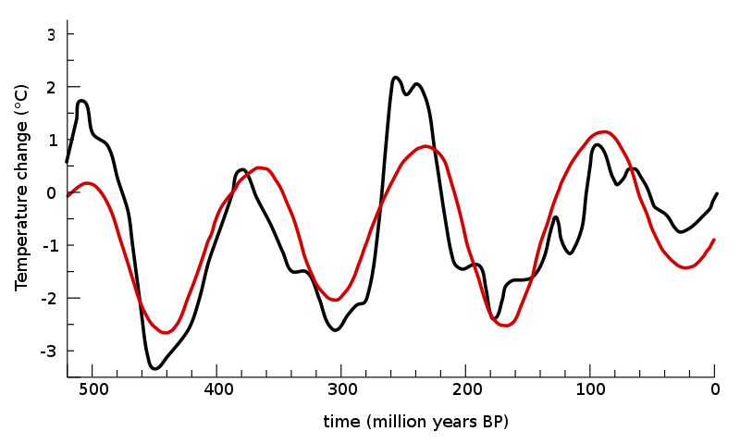
Lesson 5 - Similarity measures and Clustering
Date, Module name, Lesson number

Slide 2

Section 4: Time series similarity measures

Slide 3

What happens when we do not have labelled data?

Slide 4
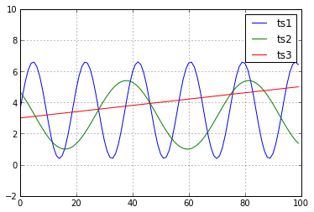
Euclidean distance is not always the best measure
Euclidean distance is not always the best similarity measure. i.e., Euclidean distance between ts1 and ts3 is smaller than ED between ts2 and ts3.

Slide 5
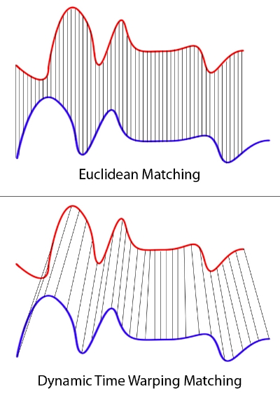
Dynamic Time Warping
Dynamic time warping (DTW) is a well-known technique to find an optimal alignment between two given (time-dependent) sequences under certain restrictions
Sakoe, Hiroaki, and Seibi Chiba. "Dynamic programming algorithm optimization for spoken word recognition." IEEE transactions on acoustics, speech, and signal processing 26.1 (1978): 43-49. (5000 citations)
https://www.youtube.com/watch?v=_K1OsqCicBY

Slide 6
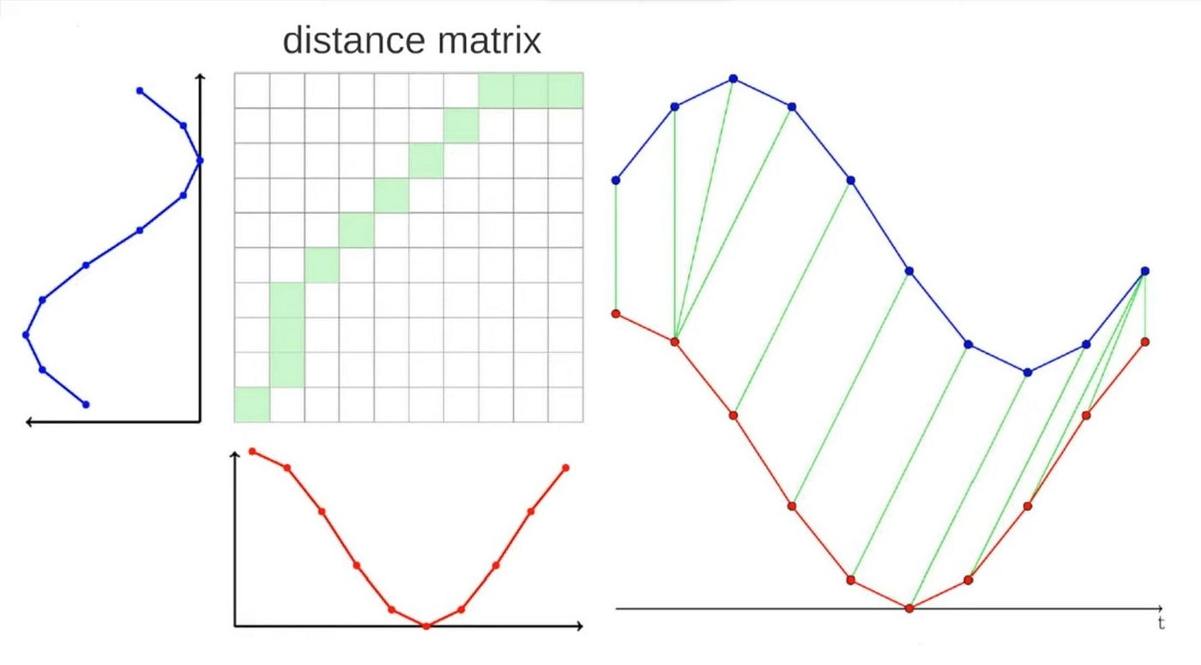
Another example of DTW
Aligns time series: Matches two time-dependent sequences by stretching or compressing them to minimize alignment cost.
Handles temporal distortions: Accounts for differences in speed or timing between sequences.
Finds optimal alignment: Identifies the best warping path to compute a similarity measure.

Slide 7
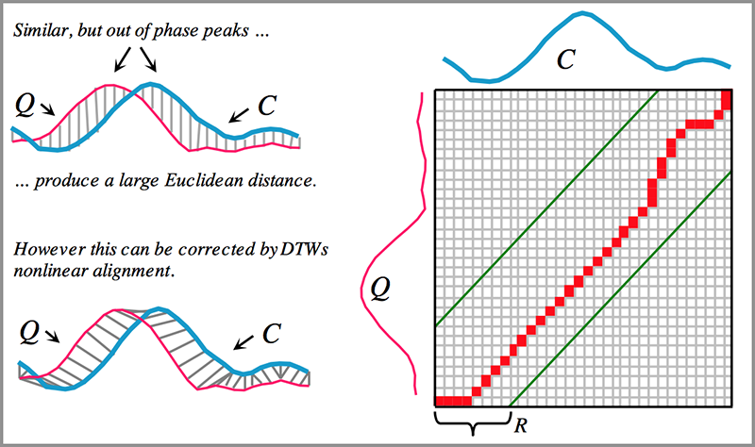
Difference with Euclidean Distance
Temporal flexibility: DTW allows non-linear alignment, while Euclidean distance compares sequences point-by-point.
Robust to phase shifts: DTW handles shifts in timing; Euclidean distance fails if sequences are misaligned.
Complexity: DTW is computationally more intensive than Euclidean distance.
Costs: DTW is O(N²) in computational complexity, compared to the O(N) of Euclidean distance for sequences of length N.

Slide 8
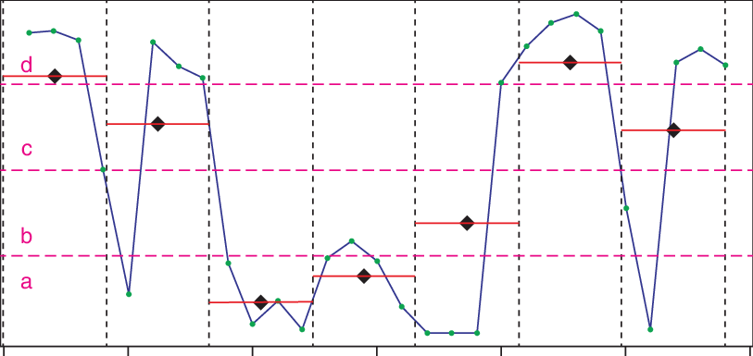
Symbolic Aggregate Approximation (SAX)
SAX is the first symbolic representation for a time series that allows for dimensionality reduction and indexing with a lower-bounding distance measure in classic data mining tasks such as clustering, classification, indexing, etc.
SAX is as good as well-known representations such as Discrete Wavelet Transform (DWT) and Discrete Fourier Transform (DFT) but requires less storage space.

Slide 9
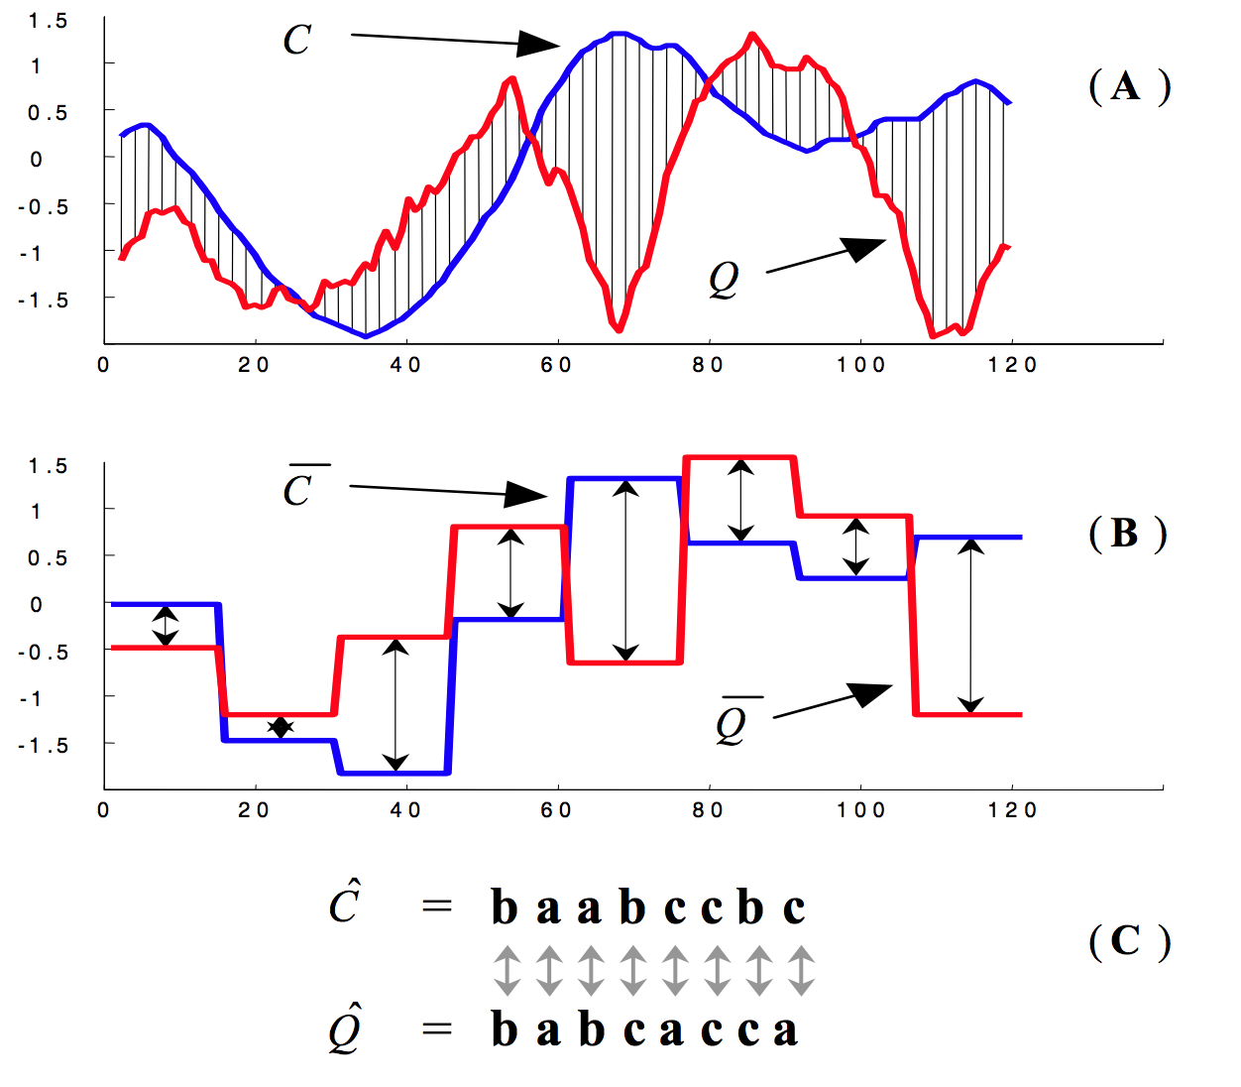
Symbolic Aggregate Approximation (SAX)

Slide 10
How can we calculate how good a new TSM is?
TRAINING SET
TESTING SET
K-Nearest
Neighbors algorithm

Slide 11
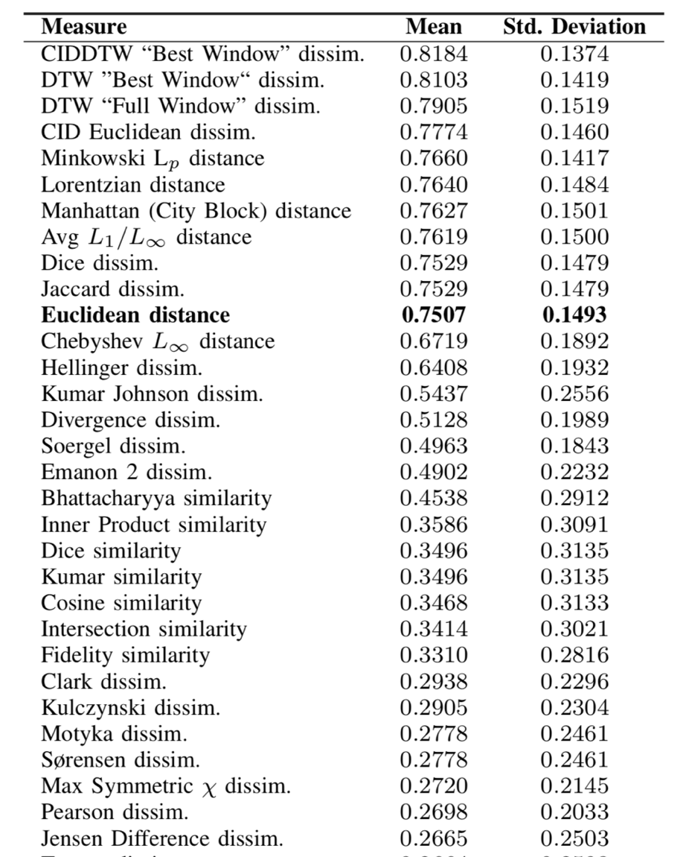
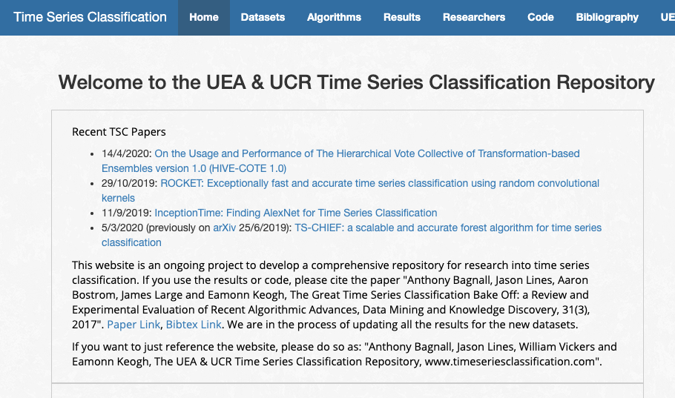
TS similarity measures ranking
http://timeseriesclassification.com
Figure 1: Best Dissimilarity measures for Time series

Slide 12
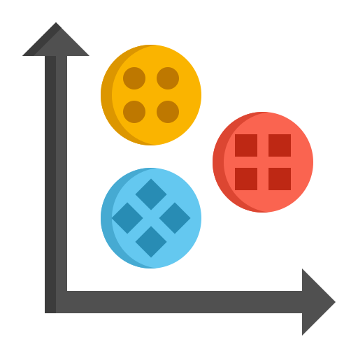
Section 5: Clustering approach

Slide 13
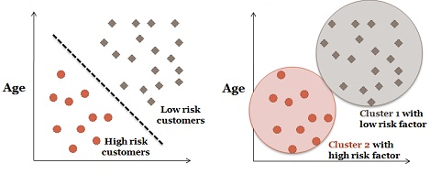
What is clustering?
Cluster analysis or clustering is the task of grouping a set of objects so that objects in the same group (called a cluster) are more similar (in some sense or another) to each other than to those in different groups (clusters).

Slide 14











Two types of clustering
Partitional algorithms: Construct various partitions and then evaluate them using some criterion.
Hierarchical algorithms: Create a hierarchical decomposition of the set of objects using some criterion.
Partitional
Hierarchical

Slide 15
Hierarchical clustering of time series in Python
https://stackoverflow.com/questions/34940808/hierarchical-clustering-of-time-series-in-python-scipy-numpy-pandas

Slide 16
Hierarchical clustering
Dendrogram result
https://stackoverflow.com/questions/34940808/hierarchical-clustering-of-time-series-in-python-scipy-numpy-pandas
16

Slide 17
Time series k-means clustering

Slide 18
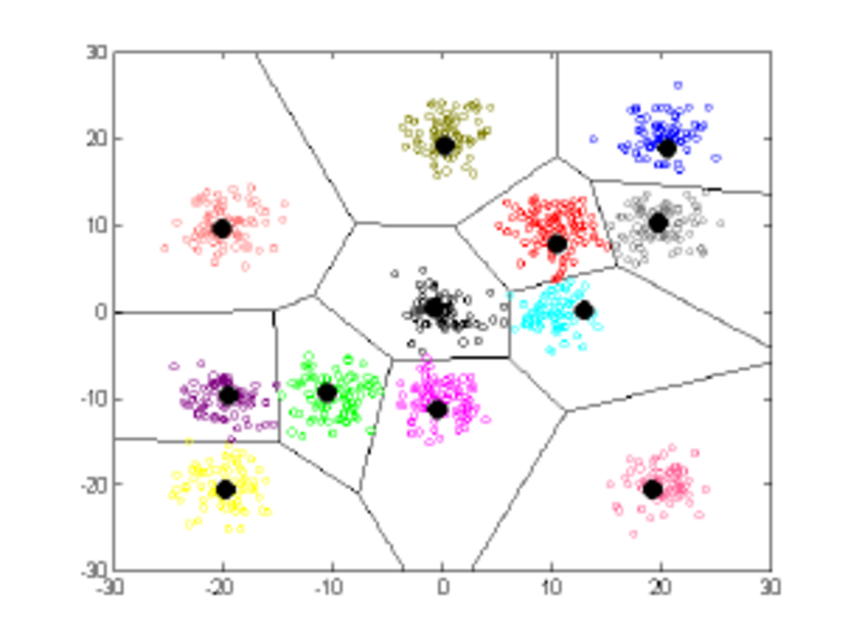
Partitional algorithms (K-means):
K-means' objective is simple: group similar data points together and discover underlying patterns.
K-means looks for a dataset's fixed number (k) of clusters to achieve this objective.

Slide 19
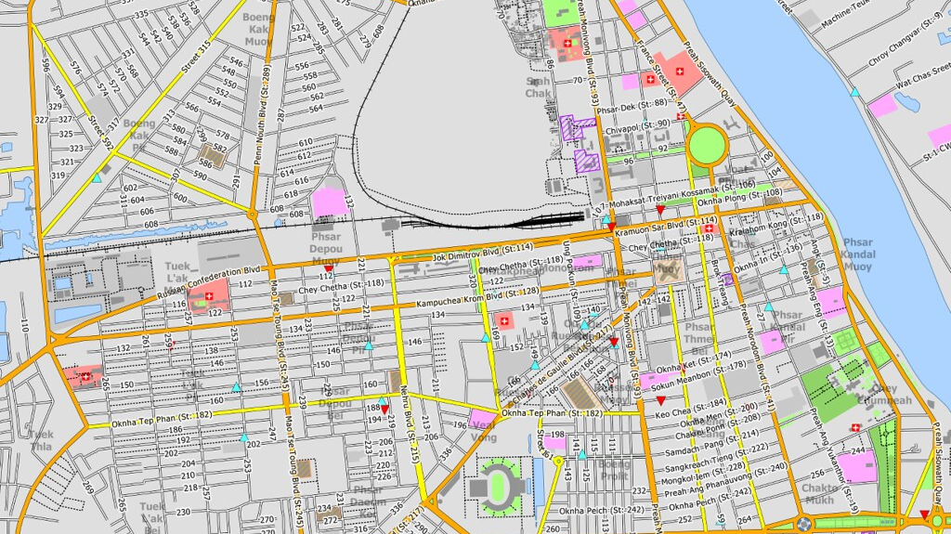
K-Means algorithm
Where is the best place to place two pizzeria if you know that there are local offices in those areas around the city?

Slide 20
Algorithm k-means
Decide on a value for k = 3.
Initialise the k cluster centres (randomly, if necessary).
Decide the class memberships of the N objects by assigning them to the nearest cluster centre.
Re-estimate the k cluster centres by assuming the abovementioned memberships are correct.
Exit if none of the N objects changed membership in the last iteration. Otherwise, go to 3.

Slide 21
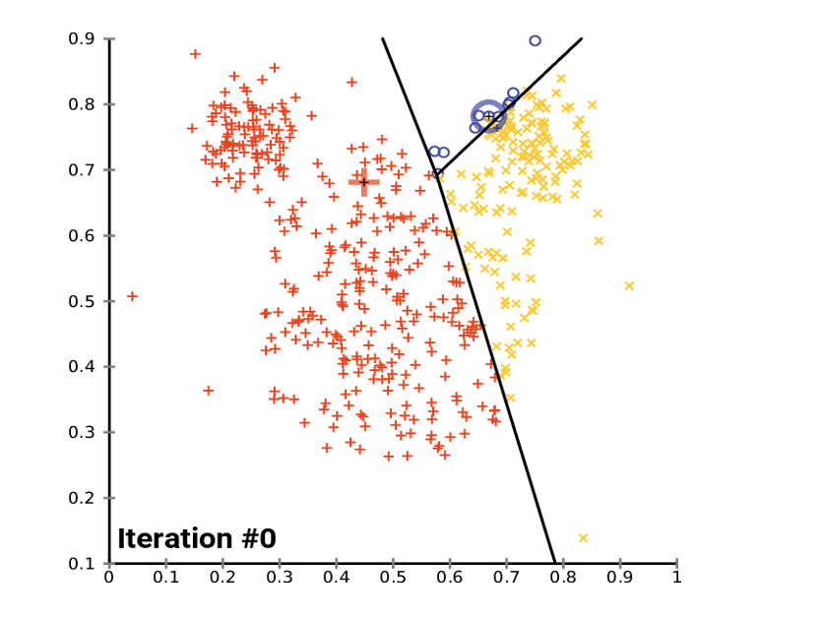
k-means illustration

Slide 22
k-means illustration

Slide 23
Comments on the K-Means Method
Pros:
Relatively efficient
Often terminates at a local optimum
Cons:
Not applicable to categorical data
Need to specify the number of clusters
Unable to handle noisy data and outliers

